Slide 1
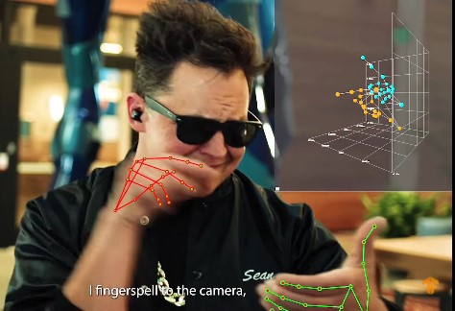
SIGN LANGUAGE RECOGNITION

Slide 2



What is the project about ?
Movement recognition of Sign language in real time
A great challenge in Computer vision to help the deaf community
Over 70 million Deaf people use sign language as their first language
Applications are not adapted yet enough to deaf people!
A massive data set available of 68 000 clips with landmarks labeled!
B

Slide 3
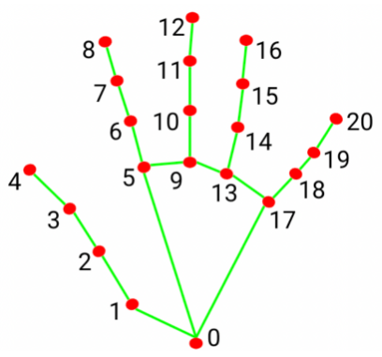
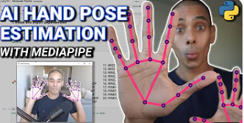
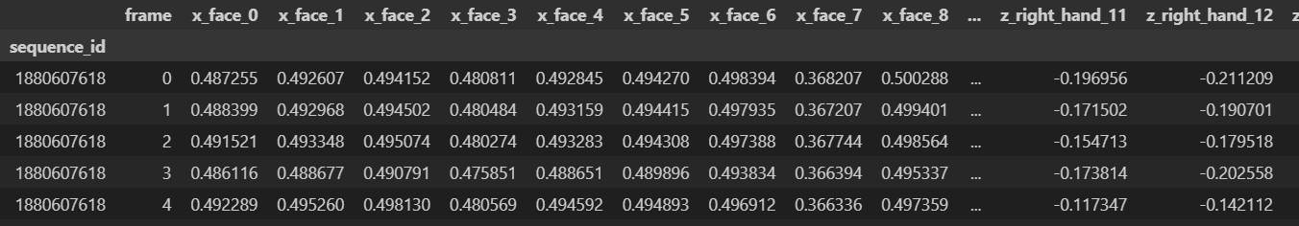
The data
O
Informations in the data for each frame
100 GB of data!
Total of 10 000 000 frames and
1630 landmarks for face, pose, and
hands in the 3 dimensions.

Slide 4
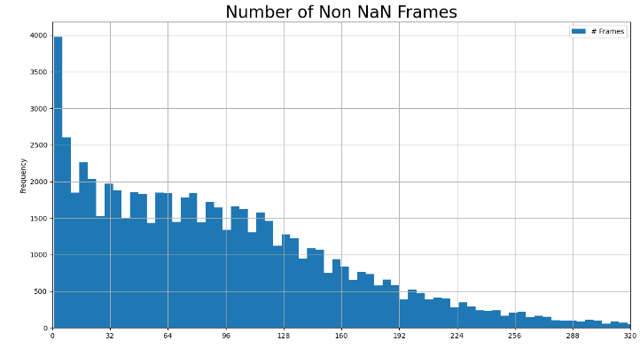
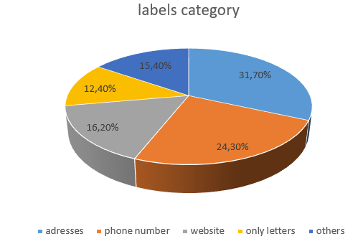
Data insights
In total, 50% of the right hand and 90% of the left hand data are missing with only few sequences without missing data
We can observe that 84,6% of data is clearly defined as a specific category
R

Slide 5
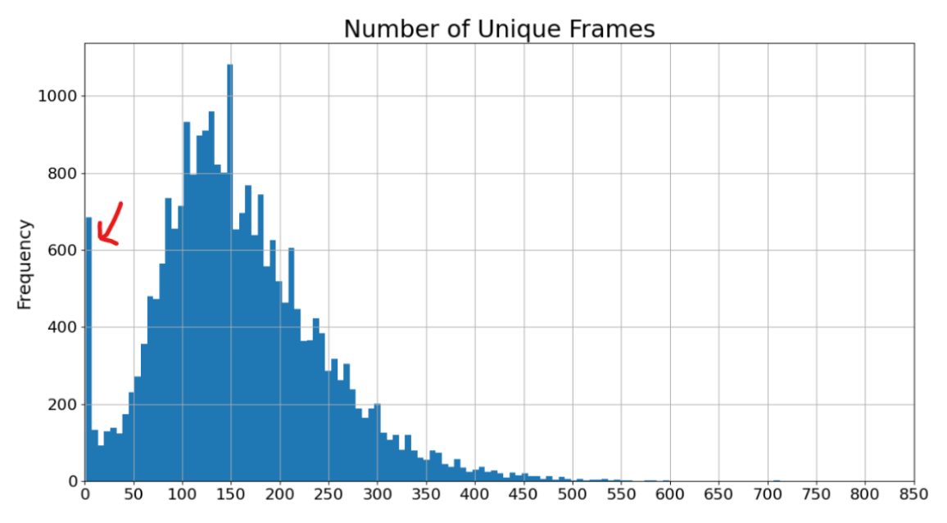
There has been an important mistake on the collection of the data by Google

Slide 6
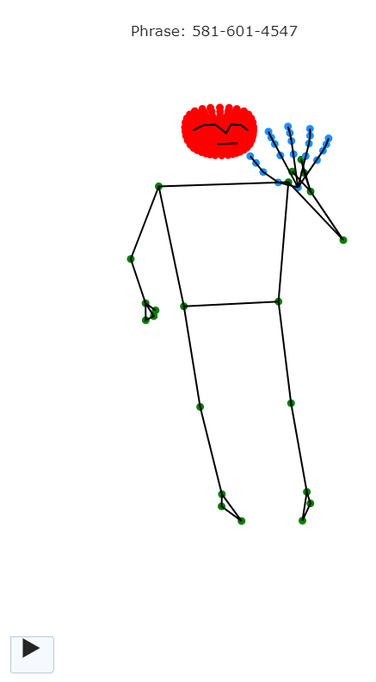
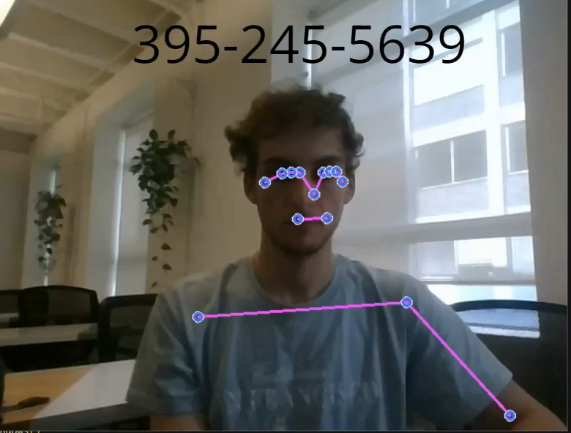
Visuals in ASL
Recreating similar video recognition for deployment
Animation of the data
N

Slide 7
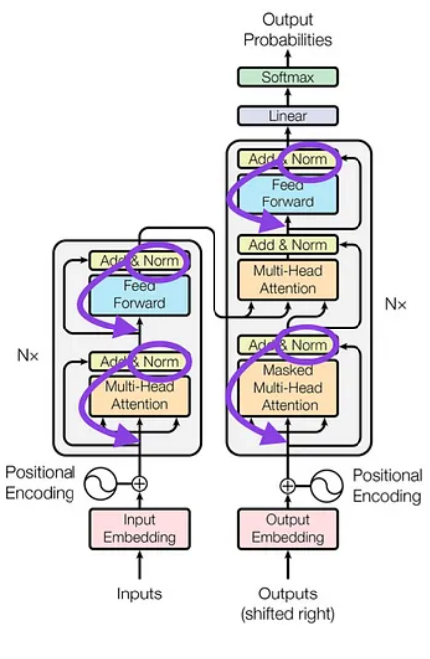
The approach in modeling
A
Pre-LN Transformer
As Transformer is the main architecture to recognize sequencial pattern with the use of attention
The process in the main 6 Steps
Research
Preprocessing
Training and tuning
Build Model
Transform output to Tflite
Streamlit
**Attention is all you need, 2017

Slide 8
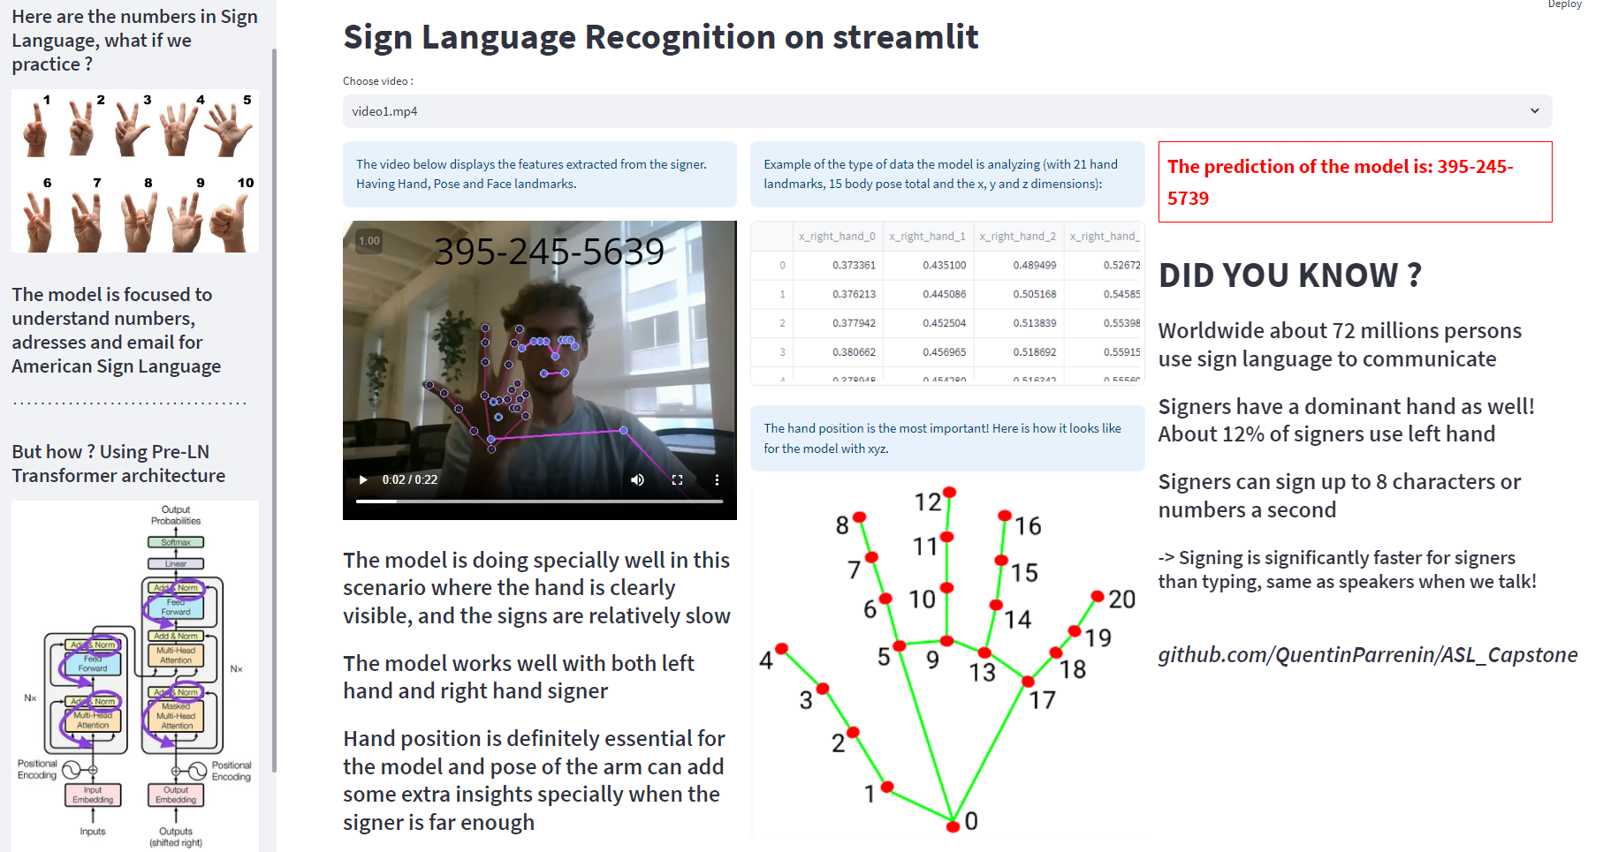

Slide 9
Thank you !
Any question ?

